Slide 1
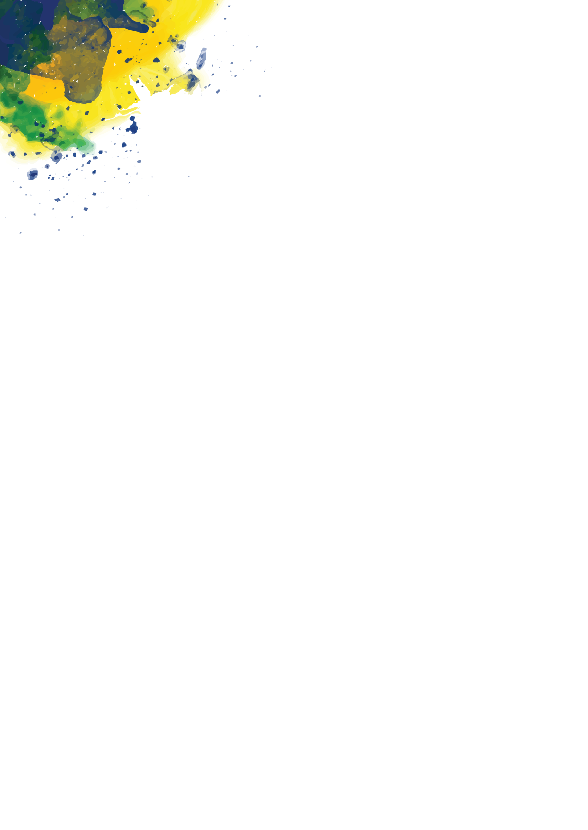


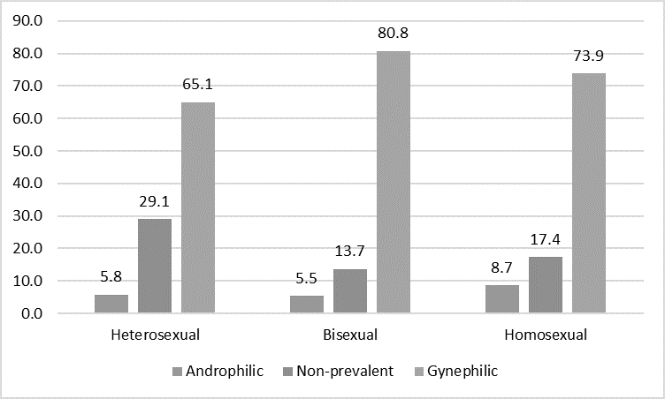
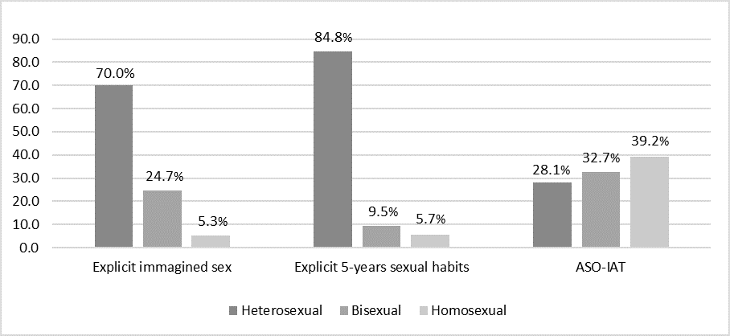
Exploring Female Sexual Preferences Worldwide: Gynephilia, Non-heterosexuality and Fluidity
Andea S. Camperio Ciani¹ & Daiana Colledani²
1: Dept. FISPPA, University of Padova, Italy; 2: Dept Psychology, La Sapienza, Roma,
Introduction
There is still a lack of reliable data regarding the prevalence of non-heterosexuality in the female population. Studying the actual prevalence of non-heterosexuality in both females and males is challenging due to the private nature of the topic and the presence of social constraints that may limit women's willingness to explicitly declare their sexual attraction. A direct investigation of individuals' sexual orientation may be influenced by social desirability and homophobia. In addition, heterosexuality and homosexuality represent the ends of a continuum that also includes different levels of bisexuality, and women and men may not fully recognize where they fall on this continuum.
As suggested by recent scientific works, a more precise representation of the prevalence of non-heterosexuality in the general population might be obtained by focusing on the sexual attraction for the same sex, which is probably a measurable indicator underlying the different degrees of non-heterosexuality. In this perspective, female gynephilia (i.e., sexual preference for women) appears to be a necessary, yet not sufficient prerequisite for non-heterosexuality. According to previous findings, examining these preferences may provide more reliable information on the phenotypic component of sexual orientation than directly examining explicitly dec5lared non-heterosexuality
Results of the study one
Discussion
In line with expectations, the results of the present work, study one showed that the rate of implicit gynephilia in women is higher than that of explicit homosexuality. Similar to previous studies in the male population, that shows a higher prevalence of implicit androphilia compared to self-reported homosexuality. Furthermore, it is also consistent with previous research suggesting that gynephilic preferences are relatively common in both males and females, including androphilic females. Although the direction of this finding is consistent with expectations, its magnitude is surprising. Indeed, 70% of participants reported gynephilic D-scores on the SP-IAT, while only 5% explicitly identified as homosexual, with very consistent values across continents. A more in-depth investigation of the SP-IAT stimuli, in the study two, suggests that women may be attracted to other women and find them beautiful and appealing, although this does not necessarily translate into a desire to have sexual encounters with them. This is also shown by the non-negligible presence of women with gynephilic D-scores on the SP-IAT, who explicitly identify themselves as heterosexual. A multivariate ANOVA revealed that mean scores on the item pertaining to actual sexual behaviors in the previous five years, did not differ across geographical areas nor religious orientation. Conversely, the scores at the item concerning imagined same-sex sexual encounters did not differ across geographical areas but differed between religious believers and non-believers. Taken together, these findings suggest that while it has been shown that androphilia is a prerequisite for homosexuality in men, gynephilia seems not necessarily a proxy for homosexuality or non-heterosexuality in women. This interpretation is also supported by the lack of correlation between D-scores on the SP-IAT and all the other implicit or explicit measures of sexual orientation, fantasy, and behavior explored (Table 2). Another difference between males and females that emerged from this work pertains to the rate of bisexuality. Similar study report in man a percentage of bisexuality close to 4%, while in this study approximately 15% of women resulted bisexual. This percentage becomes even higher if we consider the ASO-IAT measure (30% bisexual) and the explicit measures of sexual behavior (25% imagined bisexual experiences; 9% had bisexual experiences in the last 5 years). These results suggest greater sexual fluidity in women compared to men.
The results obtained on the explicit measure of sexual orientation (Kinsey Scale), shows that the majority (80.4%, N = 395) of participants declared themselves to be heterosexuals (score from 0 to 1), 14.9% (N = 73) were bisexuals (score between 2 and 4), and 4.7% (N = 23) were homosexuals (score 5 or higher). Conversely, the results at the SP-IAT depicted a different situation, with most D-scores indicating a gynephilic preference (67.8%, N = 333), a discrete percentage (26.3%, N = 129) indicating a non-prevalent preference, and only a small percentage indicating an androphilic preference (5.9%, N = 29).
Overall, the results showed a high prevalence of gynephilic D-scores across all groups (Figure 1). This pattern was observed in self-declared homosexual (73.9%, N = 17), heterosexual (65.1%, N = 257), and bisexual women (80.8%, N = 59). All these results were not significantly different among different geographic region and different religious belief.
Aim
This paper aims to measure both implicit gynephilia, and explicit sexual orientation, in a sample of females recruited online worldwide. It is hypothesized that the rate of gynephilia detected by implicit measures will be higher than the prevalence of non-heterosexuality detected by explicit measures.
In addition, it is expected to be more stable across continents than explicit non-heterosexuality.
Results study two .
Method study one
Method study two
The results at the ASO-IAT revealed that 39.2% (N = 103) of females obtained a homosexual D-score, 32.7% (N = 86) a non-prevalent D-score, and 28.1% (N = 74) a heterosexual D-score (Figure 2). These percentages were quite consistent across geographical areas, with D-scores ranging from 36.7% (North America) to 45.9% (Europe)^c. The scores at the two Kinsey items showed that non-heterosexual behaviors are quite diffused among females (Figure 2). The data show that 30% of women reported that they had imagined having sex with a woman at least sometimes (i.e., scores between 0 and 4), and 15.2% reported that, in the last five years, they had at least sometimes (e.g., scores between 0 and 4) sexual encounters with other females (5.3% exclusively or almost exclusively, scores between 0 and 1
Demographics
 | N | Percentage
Occupation
Unemployed | 105 | 21.4%
Worker | 65 | 13.2%
Employee | 181 | 36.9%
Intellectual professions | 47 | 9.6%
Other | 93 | 18.9%
Education
Basic | 1 | 0.2%
High School | 124 | 25.3%
University or higher | 366 | 74.5%
Geographical areas
Africa | 25 | 5.1%
North America | 106 | 21.6%
South America | 86 | 17.5%
Asia | 75 | 15.3%
Europe | 99 | 20.2%
Oceania | 100 | 20.4%
Age classes (Mean Age = 27.70; SD = 8.94)
18-30 years | 327 | 66.6%
31-45 years | 122 | 24.8%
46-65 years | 42 | 8.6%
Religious affiliation
Buddhism, Hinduism, Jainism, or Taoism | 24 | 4.89%
Other | 30 | 6.11%
Islam | 11 | 2.24%
Judaism | 4 | 0.81%
Christianity all variants | 164 | 33.40%
Non-Religious all variants | 203 | 41.34%
Missing or not wish to answer | 55 | 11.02%
Language of completion of the task
Fluent English | 405 | 82.5%
Fluent Spanish | 86 | 17.5%
A total of 555 participants were recruited via Prolific Academic (http://prolific.ac). Participants were eligible if they were female, aged between 18 and 65 years, fluent in English or Spanish, and provided with a device supporting the software used for running the experiment (i.e., the INQUISIT player). All participants were required to provide electronic informed consent to participate in the research project and were compensated £2 for their participation. Details on the demographics of the participants are shown in Table 1. The research protocol was the same used by Colledani and Camperio Ciani (2021) and included four tasks, administered in the following order: a short biographical questionnaire (i.e., age, gender, education level, occupation), an Autobiographical-IAT (A-IAT), the Sexual Preference-IAT (SP-IAT), and an explicit measure of sexual orientation from the Kinsey et al.
Figure 2
Interestingly, among females who declared to be exclusively heterosexual (explicit measure), 17.7% (i.e., 39 out of 221 exclusively heterosexual females) declared having imagined having sex with a same-sex person at least sometimes. Further, 5.4% (6 out of 221 exclusively heterosexual females) reported that in the last five years they have had, at least sometimes (e.g., scores between 0 and 4), sexual encounters with other females.
Correlation between explicit and implicit measures were computed. The results showed that the D-scores at the ASO-IAT negatively correlated with all explicit measures. This indicates that the lower the D-score (suggesting homosexuality) the greater the scores on explicit measures of sexual orientation or behaviors (indicating non heterosexual preferences). Explicit measures are also strongly correlated between each other. However, the D-scores at the SP-IAT did not correlate with any of the other variables, neither explicit nor implicit (Table 2)
Conclusion
Studying the prevalence of gynephilia and non-heterosexuality in adult women may be useful to better understand female sexuality in order to develop effective promotion programs for health and well-being.
Compared with explicit assessments of non-heterosexuality, implicit measures appear to be less influenced by social factors, while androphilia is a prerequisite for non-heterosexuality in men, gynephilia is not necessarily a proxy of non-heterosexuality in women, who also reveal a greater propensity for sexual fluidity than men.
A total of 263 out of 491 eligible participants accepted to be recontacted and to fill out the new survey. Participants were recruited with the same method of study one. The participants were invited to collaborate in a research project concerning the categorization of digital stimuli. For this second data collection, the research included three tasks: the ASO-IAT(autobiographical sexual orientation Implicit association method), a short questionnaire concerning sexual behaviors and habits, and a questionnaire asking to evaluate 10 pictures of males and females. The completion of the experiment took 15 minutes. In the end, participants were provided with further details concerning the objectives of the research.
. | Explicit sexual orientation | Explicit immagined sex | Explicit 5-years sexual habits | ASOIAT | SP-IAT
Explicit sexual orientation | 1
Explicit immagined sex | .725*** | 1
Explicit 5-years sexual habits | .677*** | .695*** | 1
ASO-IAT | -.249*** | -.192** | -.212*** | 1
SP-IAT | .070 | .076 | .087 | -.098 | 1
Table 1 Demographic composition of worldwide the female sample
Table 2 correlation

